Slide 1
DevOps
Workshop

Slide 2
Module 3
Objectives
Describe what is Monitoring
How different people uses it
Describe what are good KPIs for DevOps
How to define and visualize them
How to use them in meetings
Where to use the feedback
Intro on OKR’s
To add more value to the business
The Second Way and how we can empower feedback loops

Slide 3
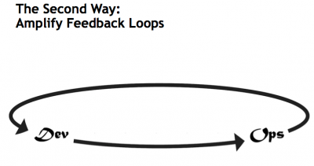
Feedback loops
“If not monitorized, not in production”
Mantra to use when trying to decide when a project is done.
Production must give feedback about behavior of the business logic implemented by development.

Slide 4
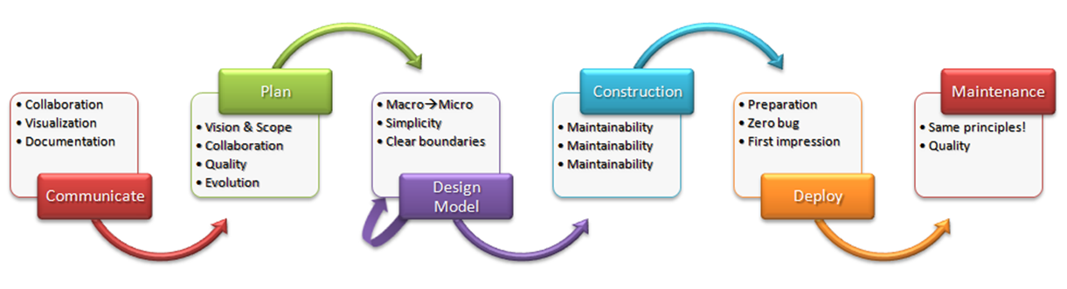
Agile Software Development Lifecycle

Slide 5
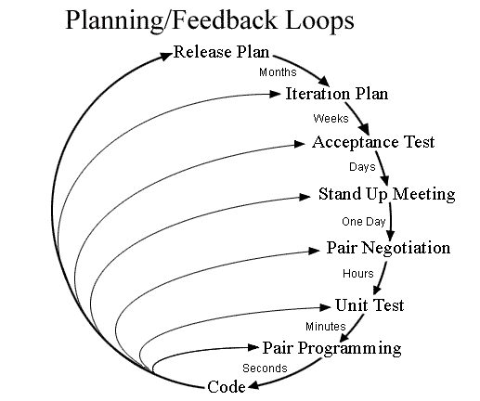
Agile Software Feedback Loops

Slide 6
Feedback loops
Requirements
Telemetry: to see and solve non-functional problems (speed, memory)
Review with development telemetry data
Create KPI’s and OKR’s to measure project objectives
Publish and share data across the stakeholders
Make Hypothesis-Driven Development (“what if?”)
Involve Business into data collection and reporting to enable non-functional requirements

Slide 7
Feedbacks loops
Outcomes
Fast feedback loops at every step of the process, enable see immediately effects of their actions and decisions.
Everyone feels productive.
Allows hypothesis driven development.
Enforces care about achieving goals.
Helps to build a culture of improvement
Enables self-consciousness and motivation

Slide 8
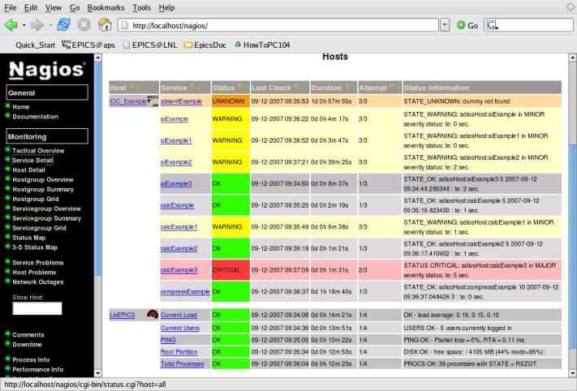
Monitoring
Typical Operations job.
Ensure all systems are operational.
Focused on service availability.
Basic system metrics:
Processes status
CPU, Memory, Disk Space
Network metrics (bandwidth)

Slide 9
Telemetry

Slide 10
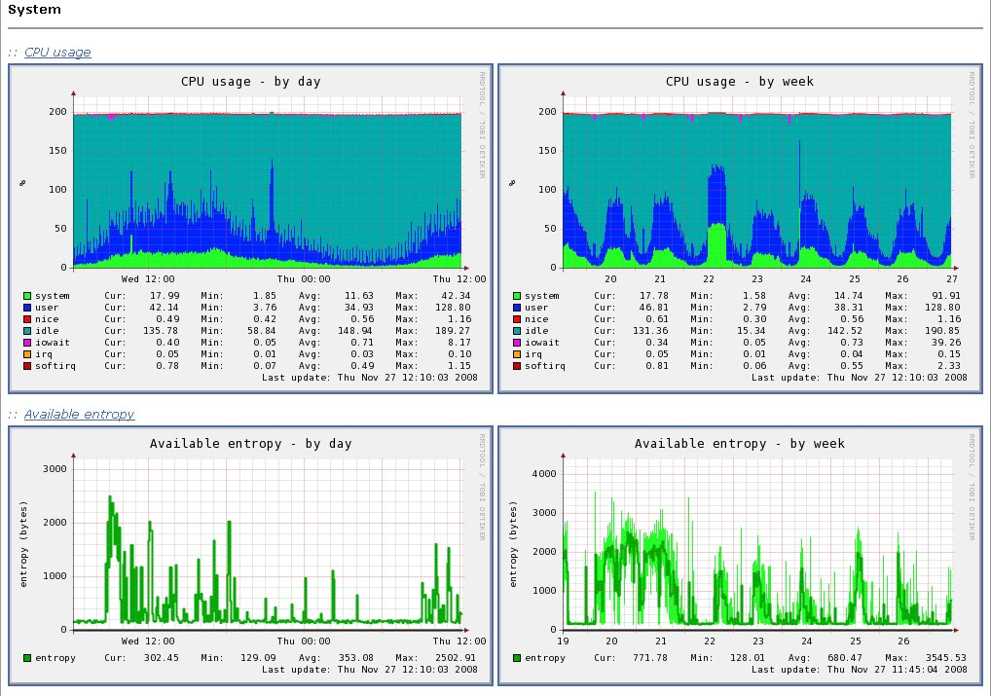
Monitoring
Trendings.
Allows to see the capacity of the asset.
Compare with old periods.
Allows to foresee problems.

Slide 11
Alerting
When something happen, call your support team.
Traditional way: call Operations team.
Problem:
Operations cannot solve all problems
Operations cannot take all decisions
Agile way: we are all IT. Call Business, Dev, QA and Ops support team.

Slide 12
Monitoring challenge
#monitoringsucks
#monitoringlove

Slide 13
Why #monitoringsucks?

Slide 14

Monitoring challenges
#monitoringsucks
pets vs. cattle
Traditional ways involve registration of servers and services into a centralized application. Scheduled test are plan to check the health of the service. Any service disruption or node outage is reported to the Operations Team.
But, how this behave with cloud platforms, where nodes are quick, easy and inexpensive to spawn? We need to change the way we see our nodes.
Introducing the analogy:
https://blog.engineyard.com/2014/pets-vs-cattle

Slide 15
Monitoring Challenges
#monitoringsucks
Monitoring does not scale well
Let’s say a node has 5 monitors (CPU, Network, Memory, Disk, and Service).
Cloud system with hundred, thousands of nodes => 5x checks per min.
If all nodes are registered against the same system, the monitoring system get collapsed.
On top of that, monitoring is not modular, so cannot be split / distributed.

Slide 16
Monitoring Challenges
#monitoringsucks
Configuration is hard
Traditional monitoring systems dated from 90’s. Configuration files are long and hard to manage using programmatic techniques. A change implies a reboot of the system. A reboot implies restarting checks… BOOM!
Configuration is a binary thing: UP or DOWN, but
What an UP or DOWN means? What implies?
Example: Disk is running out of space, ok but, at what speed?

Slide 17

Monitoring Challenges
#monitoringsucks
Too many alerts, nobody attending them
Everybody complains about having 100 daily emails about alerts sent by monitoring systems. Nobody does anything to change this.
Conclusion: alerts systems fall into oblivion.

Slide 18
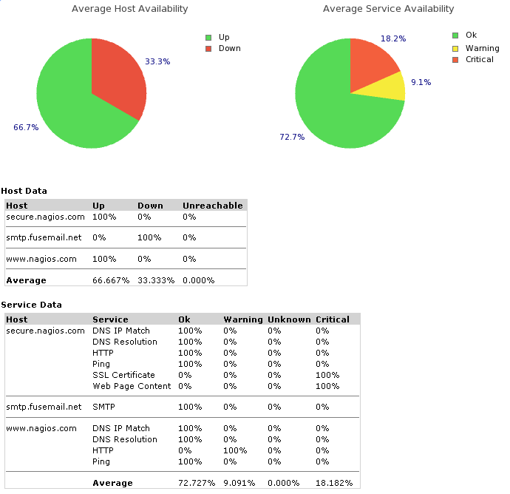
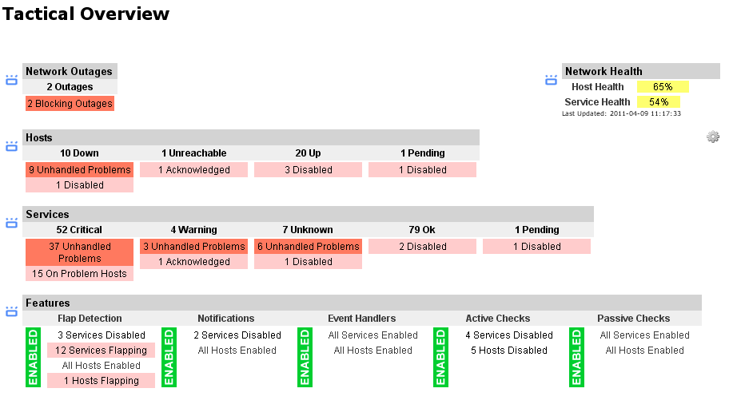
Monitoring Challenges
#monitoringsucks
Lack of good reporting tools
Just basic SLA reports. Nobody cares.
What about Operational Intelligence?

Slide 19
#monitoringlove: the answer?

Slide 20
Monitoring Solutions
#monitoringlove
A #monitoringlove movement in IRC’s, forum and source repositories answered the #monitoringsucks rant with a repo of tools, blog posts and ideas to change the perception of the monitoring systems.
Systems evolved by confrontation, so this is what we have got:
https://github.com/monitoringsucks
Notes:
Comment a little bit about this
http://www.skeptech.org/blog/2013/09/08/number-monitoringsucksless-an-anti-rant/

Slide 21
Monitoring Solutions
#monitoringlove
New monitoring systems are build scalable and distributed from scratch.
Use auto-discovery tools to detect systems and services.
Simpler and dynamically created configurations
Message passing Interfaces
API based
Better reportings
Simple interfaces to querying
And a monitoring culture with nice events:
http://monitorama.com/

Slide 22
Tools

Slide 23
Monitoring Services
In House
Nagios
Sensu
Consul
Collectd + Graphite + Grafana
Software as a Service
Pingdom
StatusCake
UptimeRobot
Notes:
http://stackshare.io/stackups/nagios-vs-sensu-vs-consul
http://stackshare.io/stackups/pingdom-vs-statuscake

Slide 24
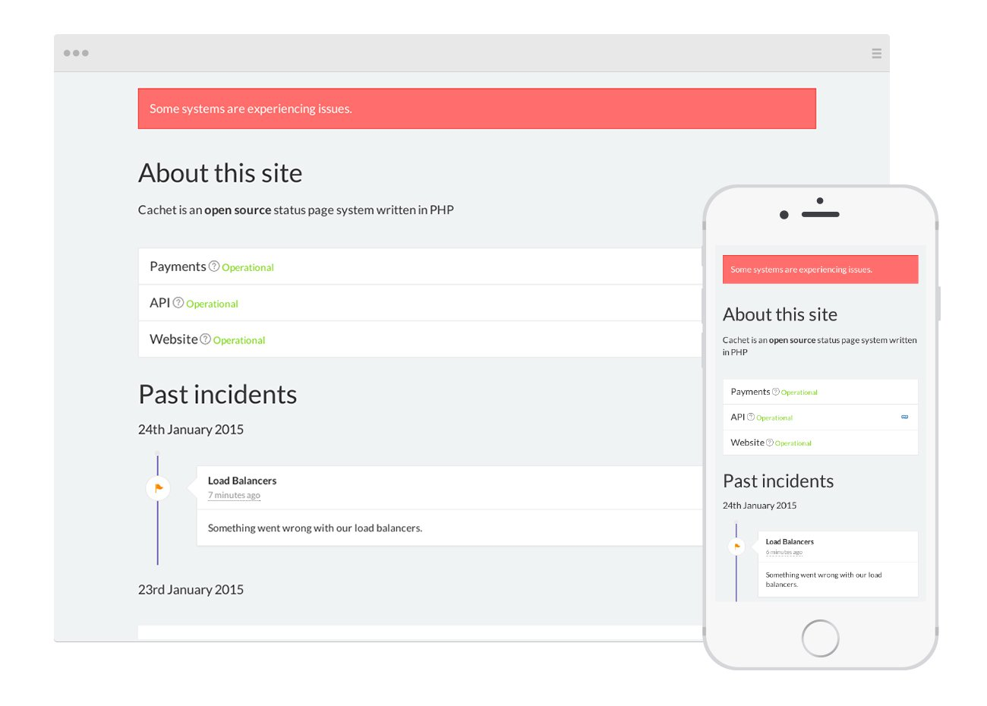
Monitoring / Alerting
Special consideration: Status Pages
Today every service must have a status page to report and give feedback about their applications status. Reporting to your users about what’s happened in an outage is critical.
Example: StatusPage.io

Slide 25
Dashboards
Are information radiators (aggregation of different relevant pieces of information) to show everybody the most relevant KPIs in “real time”. Pick data points from different sources and help to visualize them as graphs.
Examples: https://www.geckoboard.com/learn/dashboard-examples/
Tools
Geckoboard

Slide 26
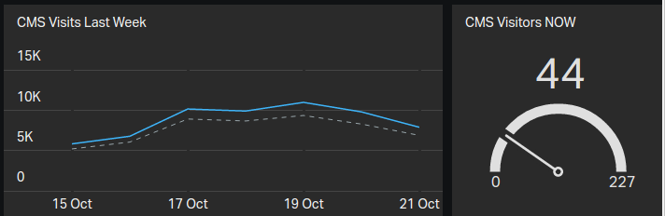
Dashboards
They need to get data from sources. To collect data from other applications or from your own application, you need to create monitoring apis directly related with your metrics.
/api/monitoring/v1/visits?from=10
{
“key”: “CMS Visitors NOW”,
“value”: 44,
}

Slide 27
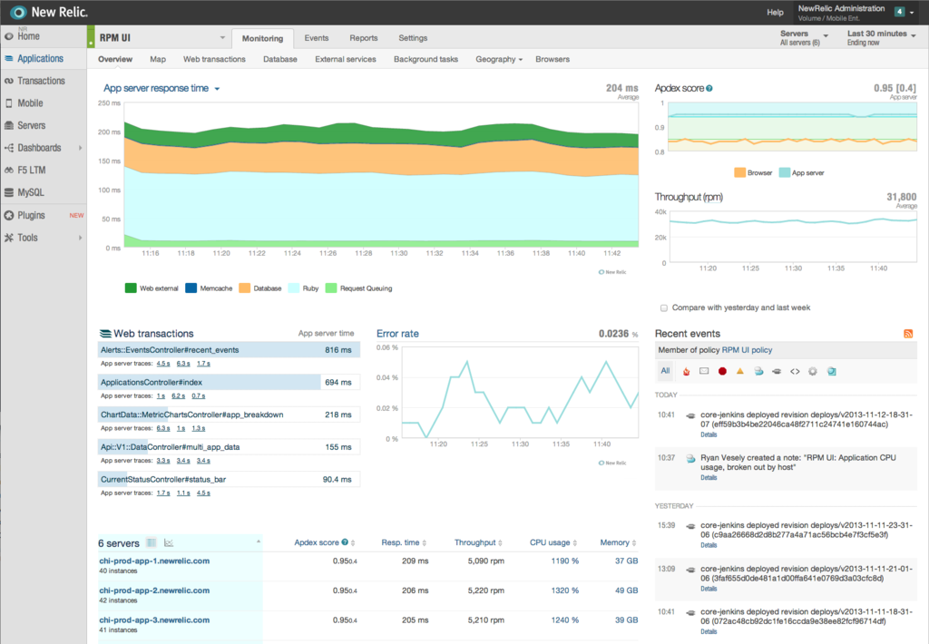
Application Performance Management
From wikipedia: “... APM strives to detect and diagnose complex application performance problems to maintain an expected level of service. APM is "the translation of IT metrics into business meaning ([i.e.] value)."^{[1]}”
Software that gets installed on your application / server and collects metrics to diagnose the behavior of your application.
Connections to backend services
Transactions and code altogether
Interactions with 3rd party services
Application architecture discovery
Great reporting tools
Notes:
Ver tutoriales de
https://learn.newrelic.com/
Sysdig Cloud
https://www.overops.com

Slide 28
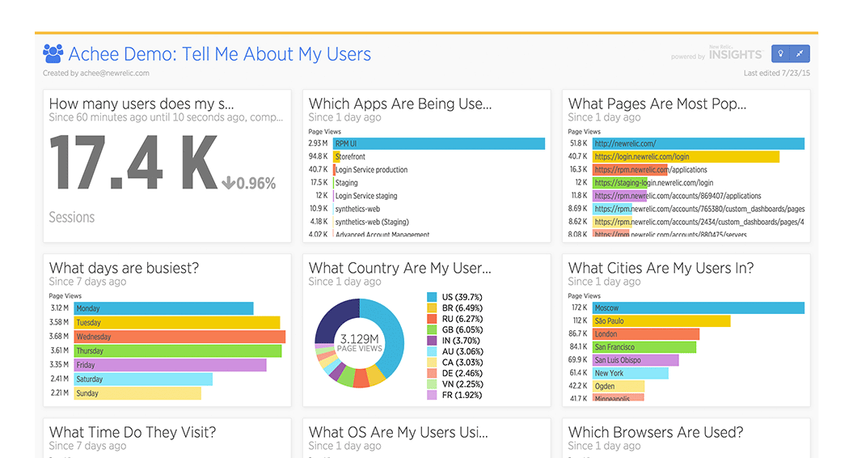

APM insights
APM collect data from your system and application. Then enable interfaces to allow people query and visualize data.
Good: Have you ever seen an IT guy crying on happiness?
Bad: Expensive. Very. Prohibitive.
Notes:
Comentar la web de newrelic sobre recursos DevOps: https://newrelic.com/devops

Slide 29

Log Management
In distributed environments, logs are the beast to beat.
Logs are the pulse of the system, but nobody wants to confront read them.

Slide 30
Log Management
A good log gives you the five W’s:
What happened?
Who is involved?
When did it take place?
Where did it take place?
Why did that happen?
https://en.wikipedia.org/wiki/Five_Ws
timestamp='2016-11-06 13:22:04 +0100'
action='noticias_tag'
format='HTML'
method='GET'
host='www.kelisto.es'
path='/noticias/actualidad?all=8&comunicaciones=3&finanzas=3&path=%2Fnoticias%2Factualidad'
user_agent='Mozilla/5.0 (Linux; Android 6.0.1; Nexus 5X Build/MMB29P) AppleWebKit/537.36 (KHTML, like Gecko) Chrome/41.0.2272.96 Mobile Safari/537.36 (compatible; Googlebot/2.1; +http://www.google.com/bot.html)'
ip='162.158.75.207'
xff_ip='66.249.69.228'
referer=''
scheme='https'
datacenter='ORD'
status='404'
measuretime='12.5'

Slide 31
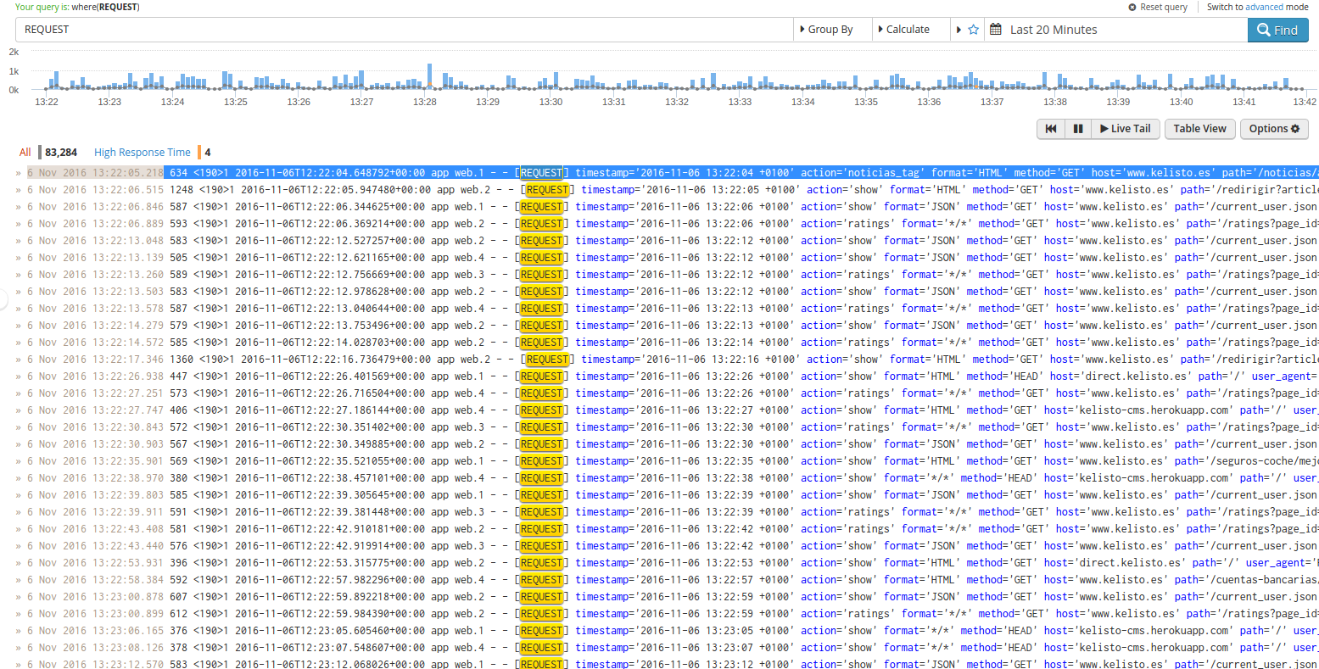
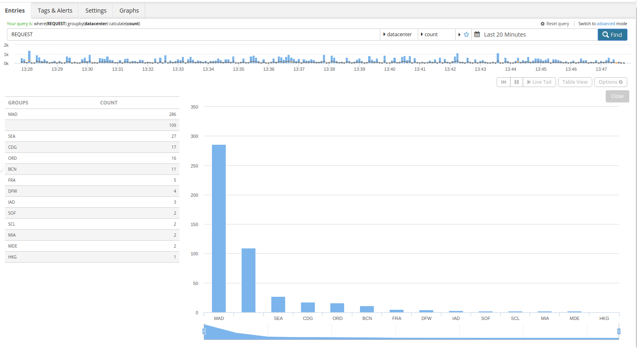
Log Management
Logs can be grouped and aggregated to create better data.

Slide 32
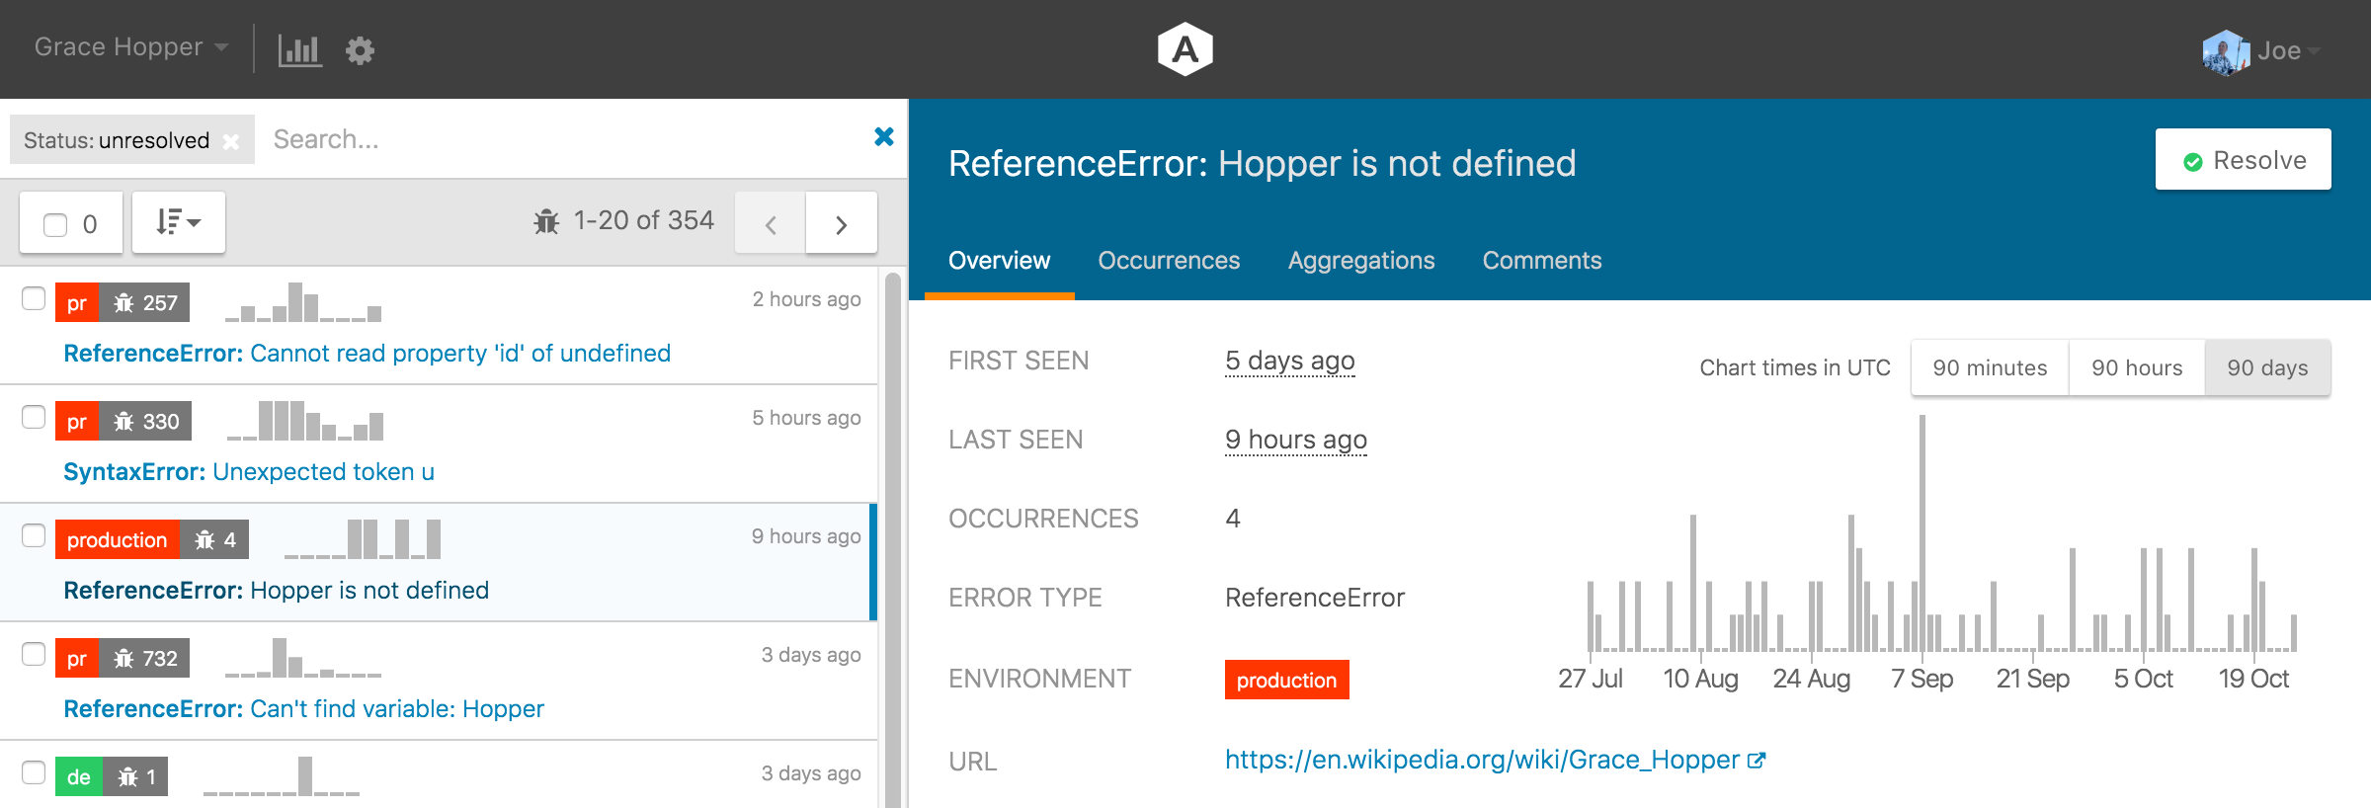
Exception Tracking Software
Tools that helps developers to track the conditions in execution time where exceptions are launched. Example: airbrake.io

Slide 33
Metrics, KPIs, OKRs

Slide 34
KPI
Key Performance Indicators
KPIs help to get insight in your business performance -- "What gets measured, gets managed". KPIs are also known as performance metrics, business indicators, and performance ratios.
Do you know what are the best KPIs for your business? No? Check this site:
http://kpilibrary.com/

Slide 35
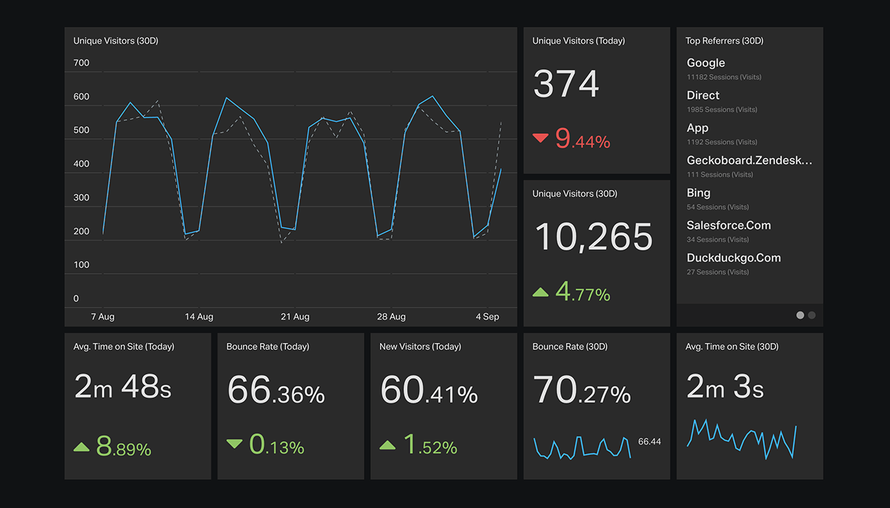
KPIs
Dashboards
Each application or service should have a dashboard of business indicators available to everybody.
Enables transparency and self-consciousness.

Slide 36
KPIs
Dashboards
Problem | Solution
Key business metrics are abstract or difficult for employees to digest | Simple, standardised visualizations that anybody can understand
Employees feel lost or need guidance | Communicate business goals to rally around that show progress
Reporting key metrics is time-consuming | Build one simple dashboard that updates automatically as data changes
Logging in to access information accross multiple platform is a pain or security risk | Bring together the most useful data from different services into one place
Trends cannot be identified easily accross systems | Bring data from multiple sources into one space to instantly get a better context
Notes:
From data dashboards best practices.pdf

Slide 37
KPIs
For DevOps
KPI | Description | Values
Deployment frequency | how often does your organization deploy code? | Multiple deploys per day Weekly Monthly ...
Lead time for changes | what is your lead time for changes (commits) go to production? | Less than one hour Between one week and one month Between one month and 6 months
Mean time to recover | how long does it generally take to restore service when a service incident occurs? | Less than one hour Less than one day Less than one week
Change failure rate | What percentage of the changes (commits) either result in degraded service or subsequently require remediations (patches)? | 0-15% 31-45% 16-30%
Notes:
From the State of DevOps Report 2016

Slide 38
KPIs
Data sources
You need data that can be streamed to a dashboard.
3rd party Integrations (new relic, pingdom)
Custom data (API’s)
/api/monitoring/v1/visits?from=10
{
“key”: “CMS Visitors NOW”,
“value”: 44,
}

Slide 39
OKR
Objective and Key Results
“OKRs stands for Objectives and Key Results. It is a method of defining and tracking objectives and their outcomes.
Its main goal is to connect company, team and personal objectives to measurable results, making people move together in the right direction.”
Wikipedia
https://www.theokrguide.com/
http://www.slideshare.net/mustansir78/guide-to-okr-objectives-key-results
Notes:
Mostrar otras aplicaciones en http://appcrawlr.com/app/related/4465450

Slide 40
OKRs
History
OKRs were invented at Intel, and made popular by John Doerr and presented to Google in 1999. They have been working with OKRs since then.
Example of OKR in NFL:
Makes $$ to the Owners <= Ambitious
Key Results:
Win SuperBowl <= Measurable
Fill stands to 88%

Slide 41
OKR
Features:
Big part of OKRs is making sure each individual knows, what's expected of them at work. Not employee evaluations.
Focus and engage people on company goals.
Synthesizes abstract objectives with measured KPI’s.
Works for mid to long term objectives.
Helps to motivate people and to measure the revenues of individuals.
OKRs are about the company’s goals and how each employee contributes to those goals

Slide 42
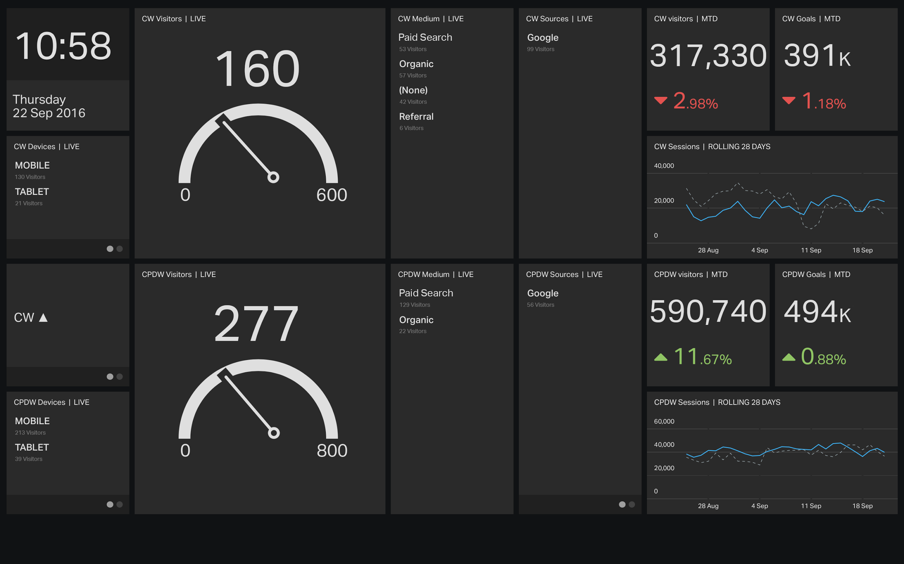
OKRs
Feedback
Create a dashboard with your Objective and key results.
Keep everybody informed and motivated.
Useful to focus only on the metrics they are responsible for
Source: https://www.geckoboard.com/learn/case-studies/ratio/

Slide 43
OKRs
Objectives
You should only have 3-5 objectives
Most should be set by the individual
Objective score is the average of the key results

Slide 44
OKRs
Key Results
Measurable
Ambitious, better farseeing than shortsighted
Self-graded
Limited to no more than 4

Slide 45
OKRs
Example
Objective | Key Results | Score (0..1) | Status | Owner
Participate in Company Culture | Attend 2 Local Meetups | 0.5 |  | Tom
 | Speak at one conference | 1 |  | Tom
 | Send 2 Pull Requests | 0 |  | Tom
 | Average | 0.5

Slide 46
OKRs
Technique: Reverse engineering to establish how to get your OKRs
Read from right to left!
Current
Status
Milestone
N-3
Milestone N-2
Milestone N-1
GOAL
4
3
2
1
So I need to do X to get to Step N-3
(actions)
And I reach this by… (Step N-3)
(actions)
And I reach this by… (Step N-2)
(actions)
I reach this by… (Step N-1)
(actions)

Slide 47
Summary Module 3
Do we have a good understanding about?
What is Monitoring
What are good KPIs for DevOps
Where to use the feedback
Second Way and how we can use data and feedback to improve value

Slide 48
Lab 3
Objectives:
We are going to use our environment to create some metrics and define KPIs that will be visualized through a service. We will use Jenkins to create and send reports.
We are going to use New Relic add-on to see how the application works and behaves under traffic.
Estimated time: 1 hour

